Slide 1



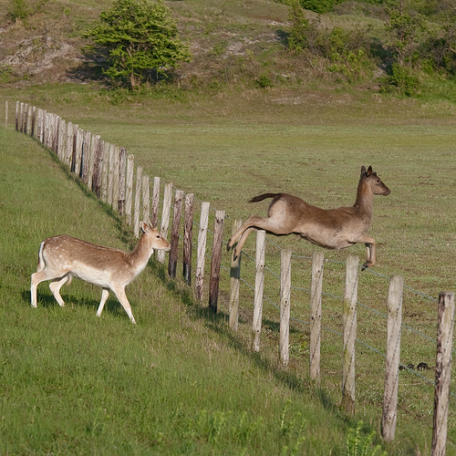
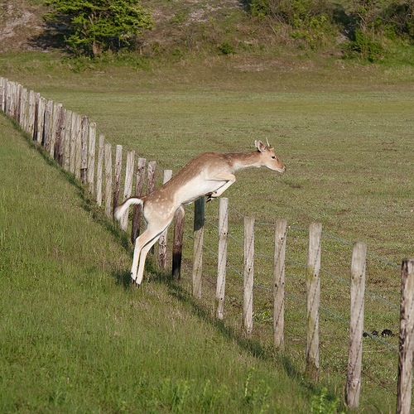
Near-Duplicate Image Detection Using Deep Learning
Francisco Reveriano
ISRS 2019 Oral Presentation
Department of Computer Engineering
University of Houston-Clear Lake
Images from Flickr MNFD Dataset¹
¹Connor, MacKenzie-Leigh, Cardillo and Moss, "Identification of MIR-Flickr Near-Duplicate Images" , VISAPP 2015, 10th International Conference on Computer Vision Theory and Applications, Berlin, March 2015.

Slide 2
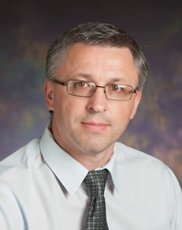
Acknowledgements
Mentor: Vlad Kindratenko (NCSA)
SROP Mentor: Nicole D. Jackson (University of Illinois Urbana-Champaign)
REU-Inclusion
SROP

Slide 3




NSF Grant
NSF Grant #: 1659702
Award Name: REU Site: INCLUSION - Incubating a New Community of Leaders Using Software, Inclusion, Innovation, Interdisciplinary and OpeN-Science
Investigators: Danial Katz & Olena Kindratenko
Sponsor: University of Illinois Urbana-Champaign

Slide 4


What is a Near-Duplicate Image?
Thagharajan: “..images with variations due to digital editing operations.”¹
Zhang: “…duplicate images are those affected by changing of viewpoint, illumination, and camera settings.”²
Kindratenko: “…whose visual context is essentially the same, but the images themselves were acquired at a different spatial or temporal point.”
Images from Flickr MNFD Dataset³
¹ Thyagharajan, Kandaswamy Kondampatti, and Governor Kalaiarasi. "Pulse Coupled Neural Network based Near-Duplicate Detection of Images (PCNN--NDD)." Advances in Electrical and Computer Engineering 18.3 (2018): 87-97.
² Zhang, Yi, et al. "Learning near duplicate image pairs using convolutional neural networks." International Journal of Performability Engineering 14.1 (2018): 168.
³Connor, MacKenzie-Leigh, Cardillo and Moss, "Identification of MIR-Flickr Near-Duplicate Images" , VISAPP 2015, 10th International Conference on Computer Vision Theory and Applications, Berlin, March 2015.

Slide 5

Detecting Near Duplicate Images is Important
Compression Algorithms
Social Media Identification of Pictures from multiple users
Detecting fake profiles or copyright infringements
Keeping inappropriate content of a social media environment
Brickley, Corey. “Facebook Content Moderators.” The Verge, 25 Feb. 2019, www.theverge.com/2019/2/25/18229714/cognizant-facebook-content-moderator-interviews-trauma-working-conditions-arizona.

Slide 6
Understanding the Problem
Model
Near Identical Image?
Images
Yes/No ?
Connor, MacKenzie-Leigh, Cardillo and Moss, "Identification of MIR-Flickr Near-Duplicate Images" , VISAPP 2015, 10th International Conference on Computer Vision Theory and Applications, Berlin, March 2015.

Slide 7
Model architecture has two components:
Pre-Trained Convolutional Neural Network
Nearest Neighbor Map
Input Image
Image Features
Nearest Neighbor Image
Special Because:
Convolutional Neural Network is not utilized for classification.
Convolutional Neural Network weights are the pre-trained weights from ImageNet.
Features are derived from the last layer before the classification layer.

Slide 8
1st Step is Training the Model for Testing.
Image Database
Pre-Trained Convolutional Neural Network
Nearest Neighbor Algorithm
Image Features
Nearest Neighbor Map
All Images in the Image Database are Mapped
Nearest Neighbor Map is prepared for Testing

Slide 9
2nd Step is Testing the Model.
Pre-Trained Convolutional Neural Network
Nearest Neighbor Algorithm
Nearest Neighbor Image
Test
Image
Image Features
Utilizes the Nearest-Neighbor Map that was in the previous step produced
At the end we check if Nearest Neighbor Image Produced is correct.

Slide 10
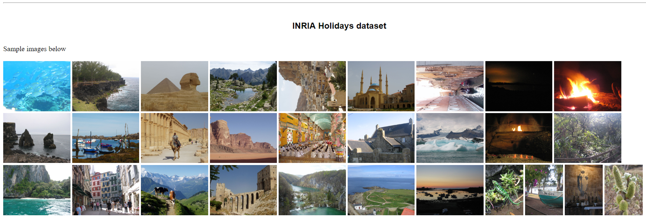
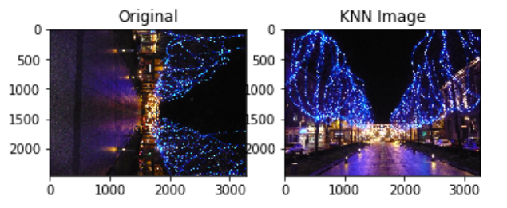
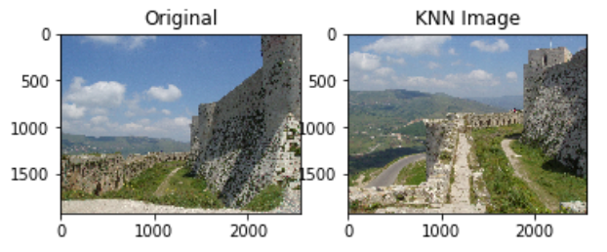
First commonly used dataset for testing.
Result Images from Testing
1491 Images
500 Query Images
Herve Jegou, Matthijs Douze and Cordelia Schmid m "Hamming Embedding and Weak geometry consistency for large scale image search“, Proceedings of the 10th European conference on Computer vision, October, 2008

Slide 11
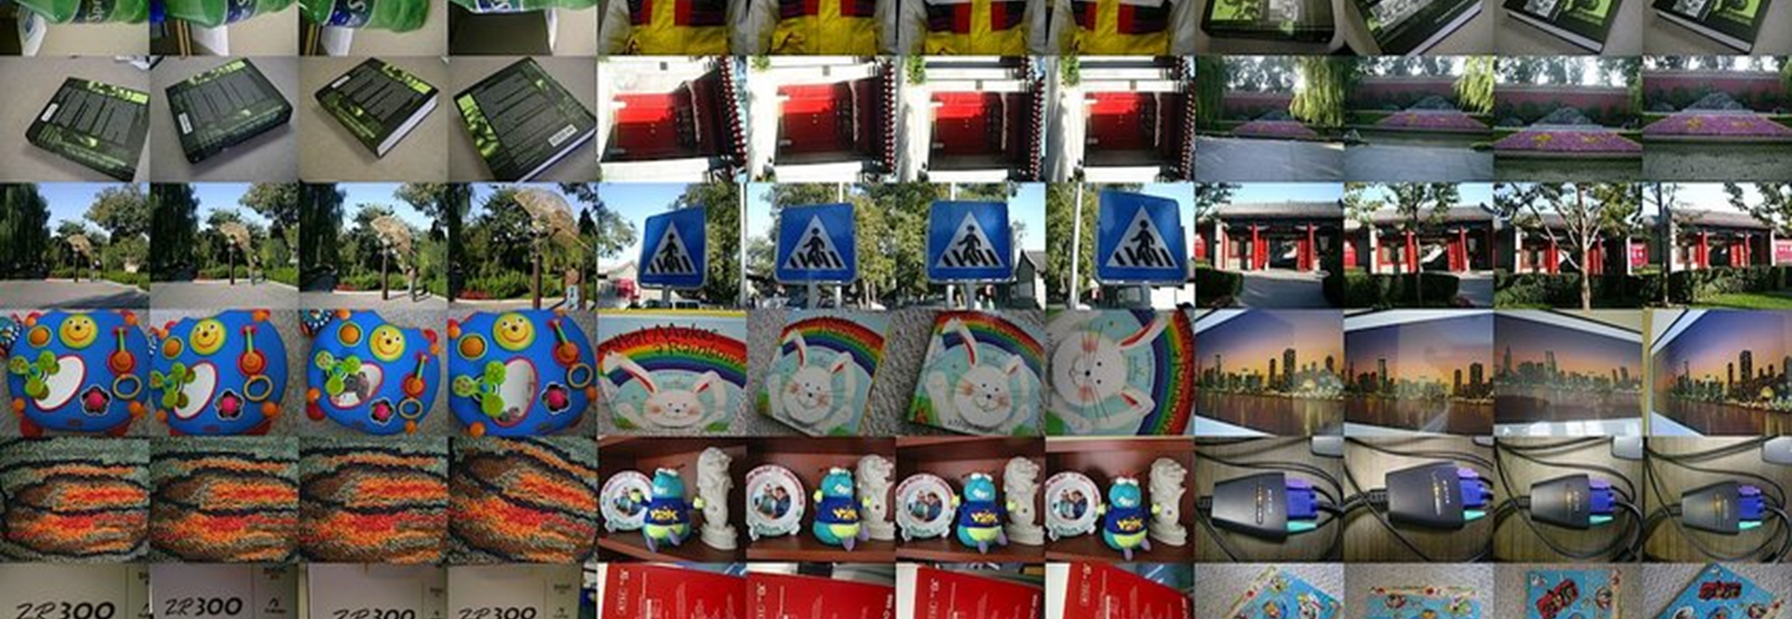
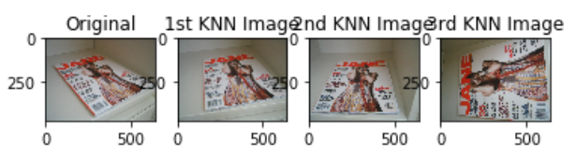
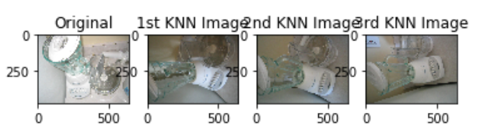
Second commonly used dataset for testing.
Result Images from Testing
Images in groups of 4
UKBench Dataset
10200 Images
2500 Groups
Nister, David, and Henrik Stewenius. "Scalable recognition with a vocabulary tree." Computer vision and pattern recognition, 2006 IEEE computer society conference on. Vol. 2. Ieee, 2006.

Slide 12
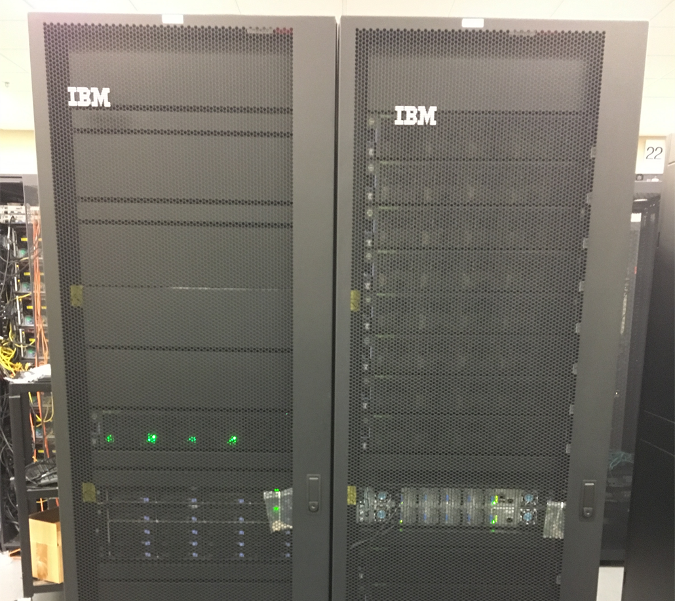



NCSA Hardware-Accelerated Learning Cluster
NVIDIA V100 GPU²
Tensorflow & Keras³
Watson Machine Learning Accelerator⁴
¹https://wiki.ncsa.illinois.edu/display/ISL20/HAL+cluster?preview=/82510177/82510183/IMG_0263.JPG
²htthttps://miro.medium.com/max/750/0*a6XSwHsfvz_oWSSJ.jpg
³ps://www.nvidia.com/en-us/data-center/tesla-v100/
⁴https://www.ibm.com/us-en/marketplace/deep-learning-platform

Slide 13
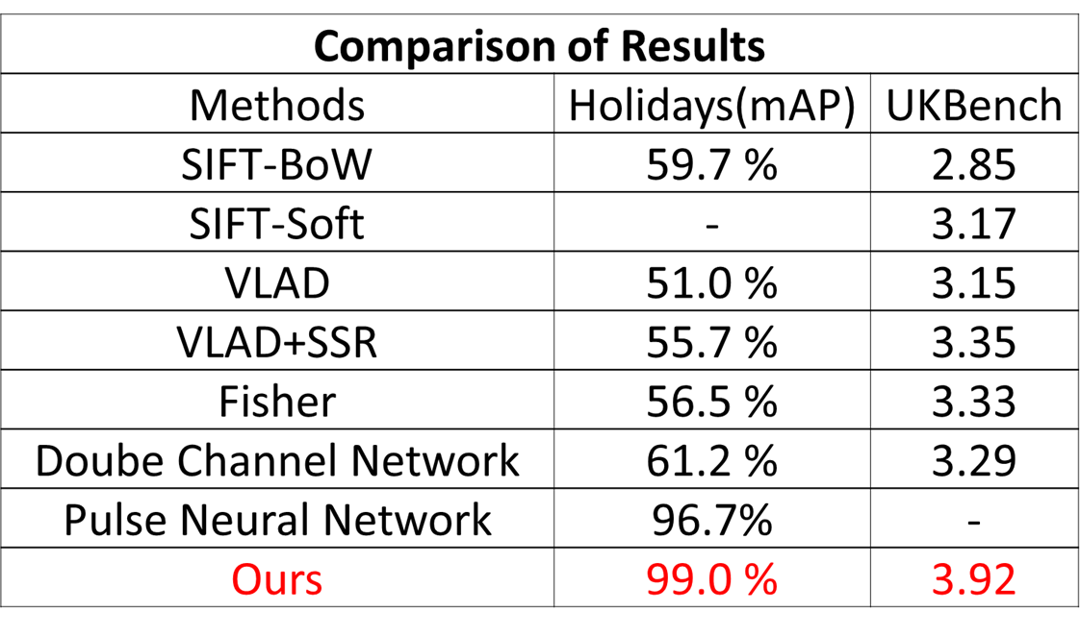
Our Architecture outperformed all previous methods.
Max is 4.0
Max is 100%

Slide 14
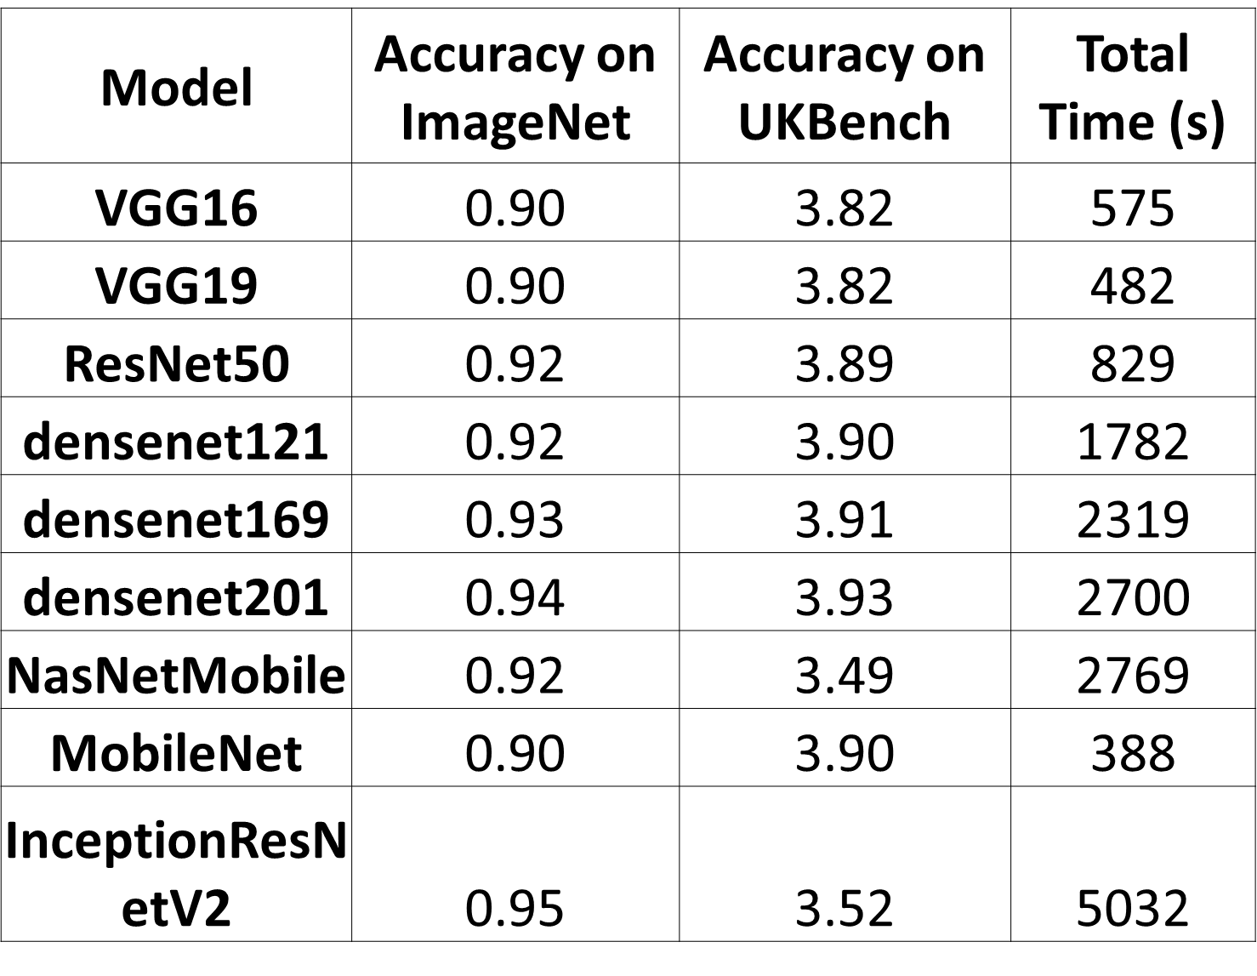
Densenet201 is the most accurate but MobileNet is the most efficient.
Accuracy of pre-trained model on ImageNet as provided by Keras.¹
Densenet201 feature representation provides the greatest accuracy.
But takes 2700 seconds for total run time.
MobileNet Provides the best balance between accuracy and total run time.
Zoph, Barret, et al. "Learning transferable architectures for scalable image recognition." Proceedings of the IEEE conference on computer vision and pattern recognition. 2018.

Slide 15
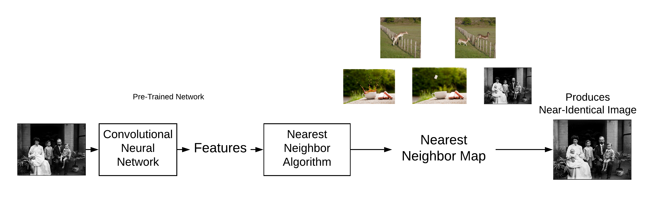
Combining a pre-trained network and nearest-neighbor algorithm is the most accurate method.
Evaluate the different front-ends.
Able to compare with traditional approaches to the problem.
DenseNet201 provided a 3.93 in accuracy but took 2699 seconds to be processed on HAL.
MobileNet provided 3.90 in accuracy and took only 388 seconds making it the ideal pre-trained Network for this architecture.
fr5@Illinois.edu

